Slide 1
Information Visualization
Texas Advanced Computing Center

Slide 2
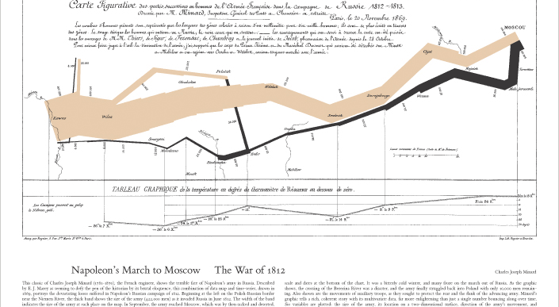
Napoleon Vs. Russia, 1812-1813
Notes:
Napoleon’s march across Poland and Russia by Charles Joseph Minard, showing the war of 1812.
Note what is missing: a map.
Each notch in the graph indicates a battle.
Temperature and a time scale are shown on the bottom axis

Slide 3
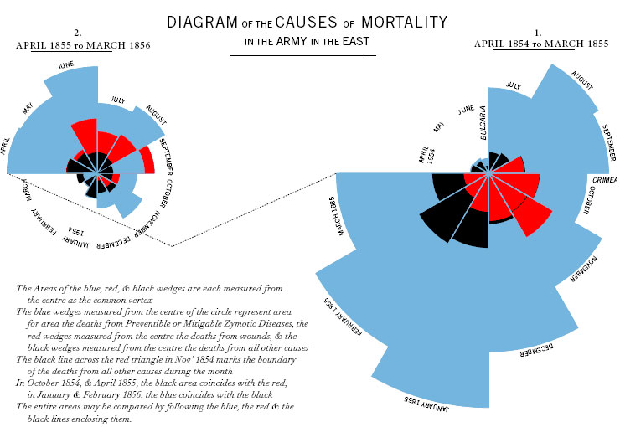
Florence Nightingale Cox Comb
Notes:
Florence Nightingale’s analysis of causes of death during the Crimean War
Red = death in combat
Blue = death due to preventable causes (mostly bacterial infections)
Black = accidents (friendly fire, etc.)
This visualization had a major impact on British public policy after the Crimean War: they invested more heavily in army hospitals and had strict policies on hygiene.

Slide 4
Data Analysis vs. information visualization
Data analysis:
  process data to extract knowledge.
What does information visualization do?
Human
Data
Information Transfer

Slide 5
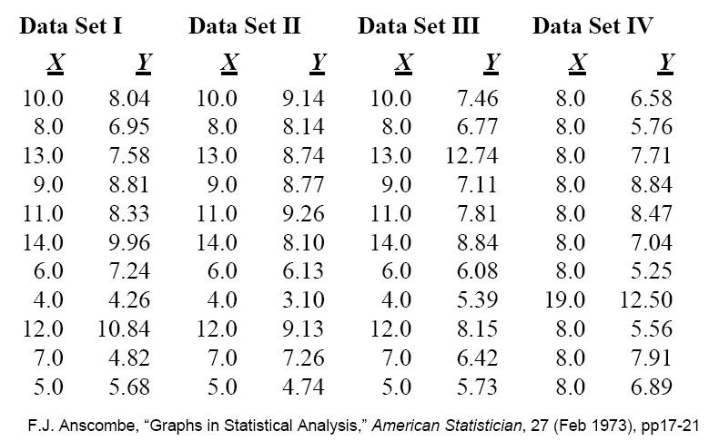
Why Visualize?
Anscombe's Quartet

Slide 6
Why Visualize?
Simple statistical analysis
Conclusion?
  Four data sets are, statistically, same?
mean | 9.0 | 7.5 | 9.0 | 7.5 | 9.0 | 7.5 | 9.0 | 7.5
variance | 10.0 | 3.75 | 10.0 | 3.75 | 10.0 | 3.75 | 10.0 | 3.75
correlation | 0.816 |  | 0.816 |  | 0.816 |  | 0.816
regression | Y=3+0.5x |  | Y=3+0.5x |  | Y=3+0.5x |  | Y=3+0.5x

Slide 7
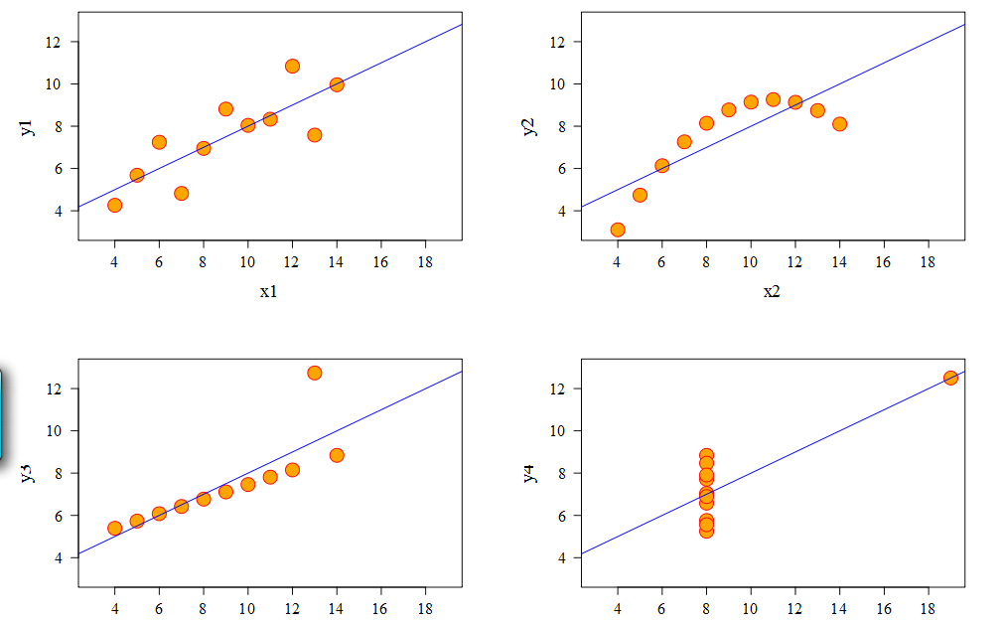
Why Visualize?
Linear?
Positive linear
Is something wrong here?
Linear with outliers

Slide 8
In the simple case
Line Graph
  x-axis requires quantitative variable
  Variables have contiguous values
  Familiar/conventional ordering among ordinals
Scatter Plot
  Convey overall impression of relationship
  between two variables
Bar Graph
  Comparison of relative point values
Pie Chart
  Emphasizing differences in proportion
  among a few numbers
  Histogram vs. Pie

Slide 9
From Data to Graph
Information Type:
  Easy case: 1D, 2D, 3D spatial
  What about more dimensions
  Graph data
    Tree
    Network
    Graph
  Text and document collections

Slide 10
Simple InfoVis Model
Data
View Port
Visual Mapping

Slide 11
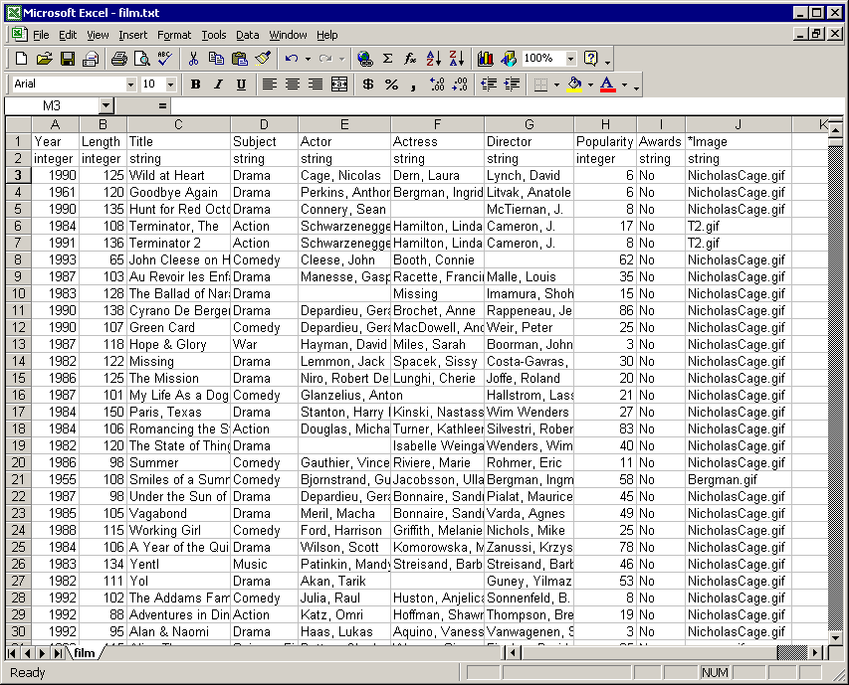
Visual Mapping: Step 1
Map: data items → visual marks
Visual marks:
    Points
    Lines
    Areas
    Volumes
    Glyphs

Slide 12
Visual Mapping: Step 2
Map: data items → visual marks
Map: data attributes → visual properties of marks
Visual properties of marks:
    Position, x, y, z
    Size, length, area, volume
    Orientation, angle, slope
    Color, gray scale, texture
    Shape
    Animation, blink, motion

Slide 13
Example: A movie database
Attributes
Types:
Quantitative
Ordinal
Nominal/Categorical
Items
(aka: cases, tuples, data points, …)

Slide 14
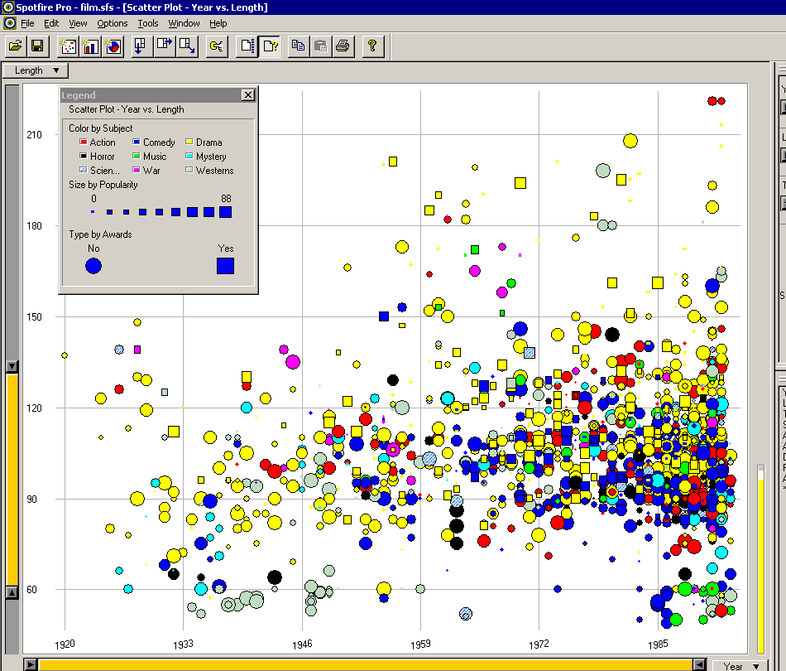
Example: A Movie database
Year → X
Length → Y
Popularity → size
Subject → color
Award? → shape
Notes:
Spotfire = well-regarded biz vis tool
Taking columns of the database and mapping
Gone with the wind is very long, and made in 1939 (hidden by legend)

Slide 15
Accuracy of Visual Attributes
Position
Length
Angle, Slope
Size
Color
Shape
Increased accuracy for quantitative data

Slide 16
Map n-D space onto 2-D screen
Visual representations:
  Continuous
    Heatmap, heightfield, volume
  Multiple views
    E.g. plot matrices, brushing histograms, …
  Complex glyphs
    E.g. star glyphs, faces …
  More axes
    E.g. Parallel coords, star coords, …

Slide 17
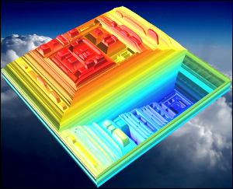
Continuous approximations
Reduce a high-dimensional data set to 2D or 3D
Principal component analysis (PCA):
  determine 2-3 significant vectors
  Represent data as linear combinations of those vectors
Topological Landscapes (Weber et al. 07, Harvey et al. 10)
Are PCA axes relevant?
Notes:
Brushing and Linking : select points in one view and have them shown in another

Slide 18
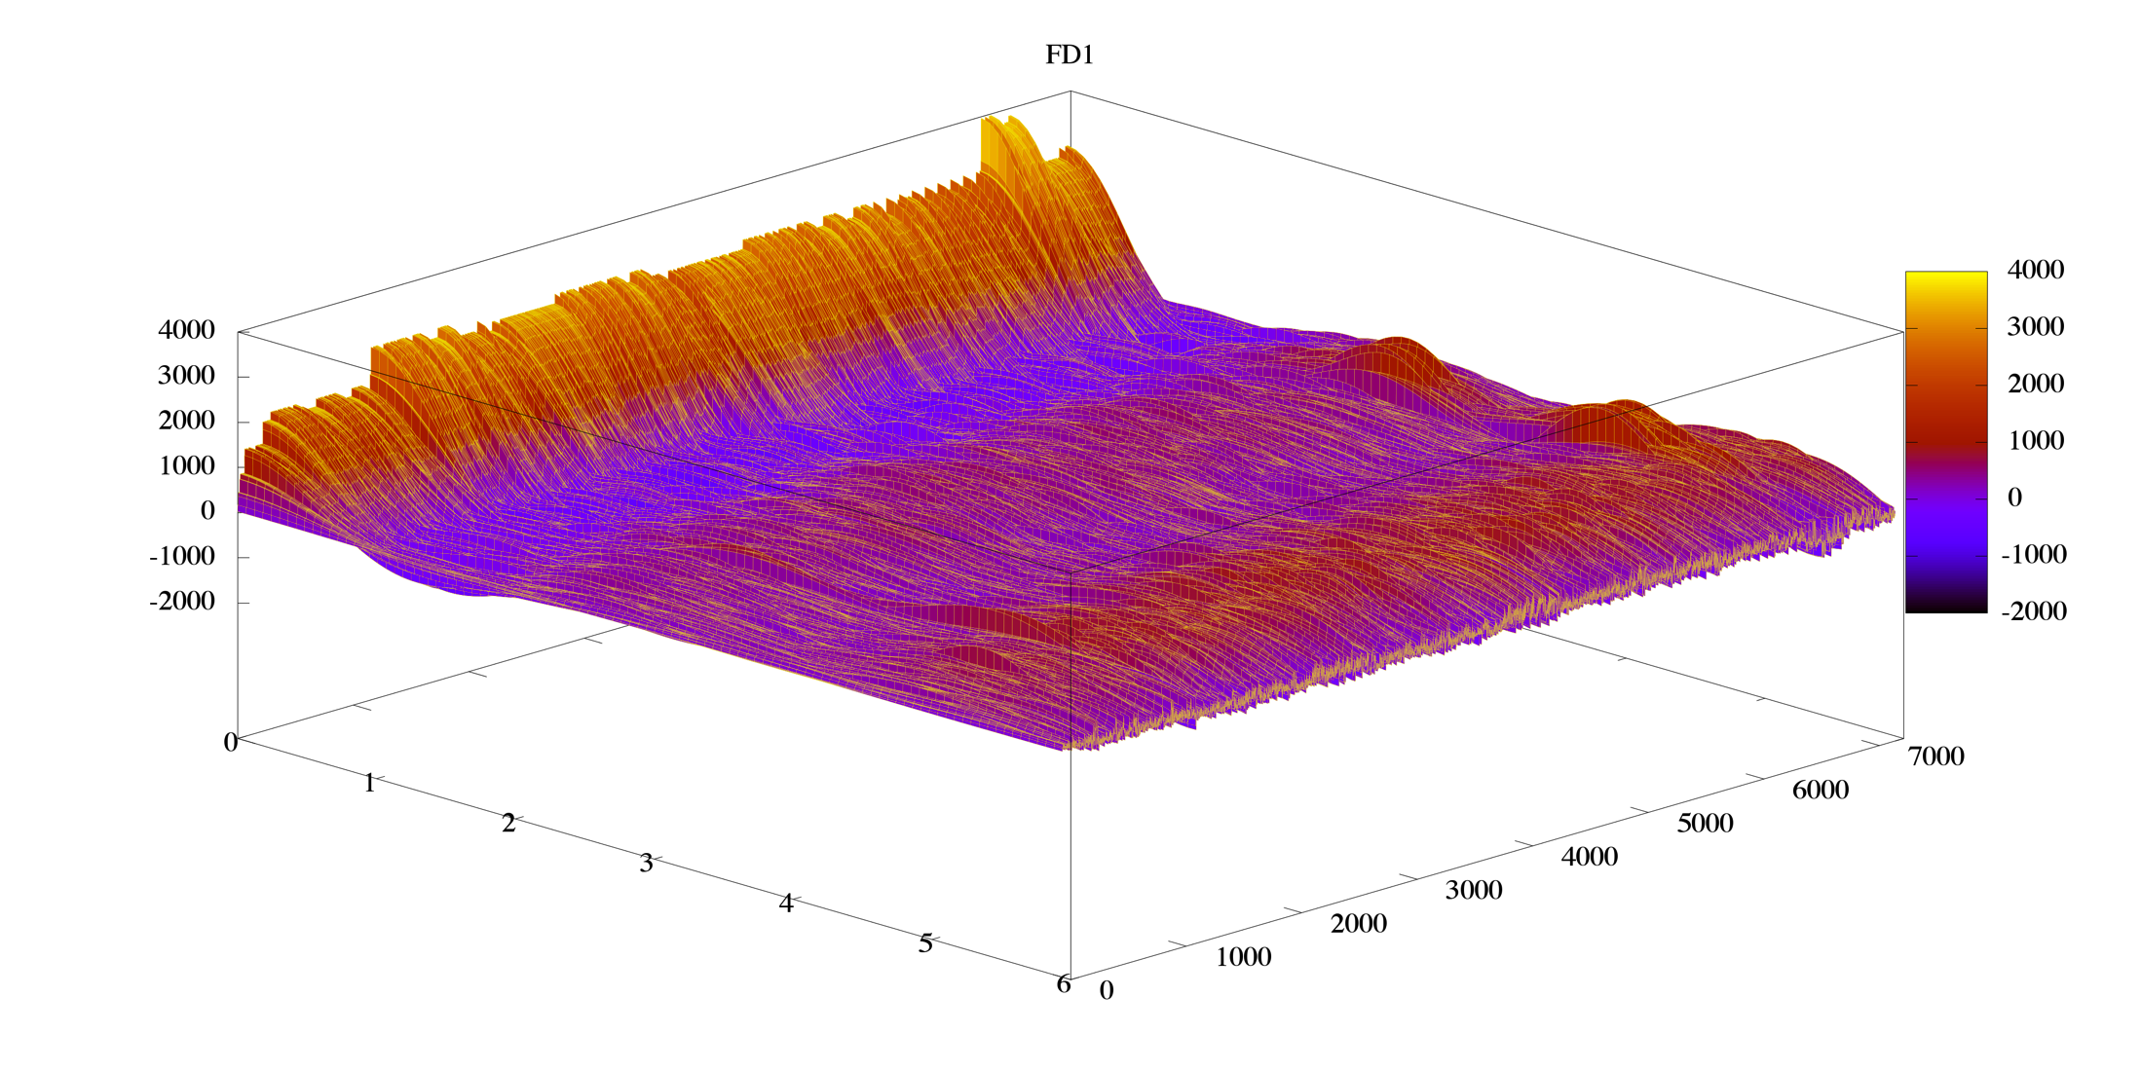
Continuous Descriptors
Transform spatial data into another doman
  Histogram
  Fourier transform, other spectra
Fourier spectra of 7000 carbon molecules with 6 atoms or less
Notes:
Brushing and Linking : select points in one view and have them shown in another

Slide 19
Multiple Views
Basic idea:
  Showing multiple views of same data set at the same time.
  Each individual visualizations might be of same or different types.
  Brushing and linking
    With interactive visualizations, All views might be linked so that action, such as selection, on one view might be reflected in all other views.
Example: Scatter plot matrix
  Create a 2d views for all attributes pairs

Slide 20
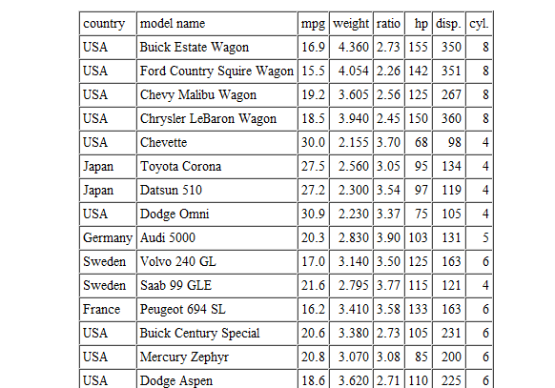
Example Data

Slide 21
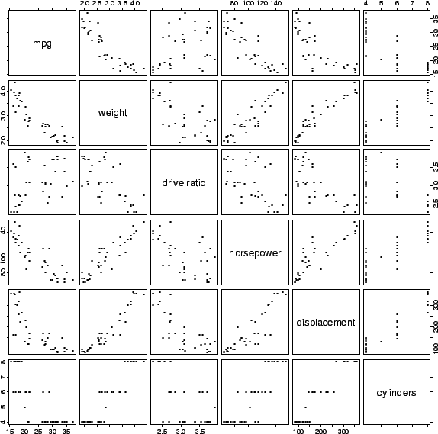
Scatter plot Matrix Example

Slide 22
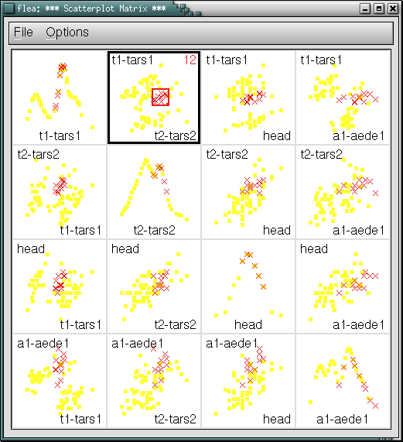
Brushing

Slide 23
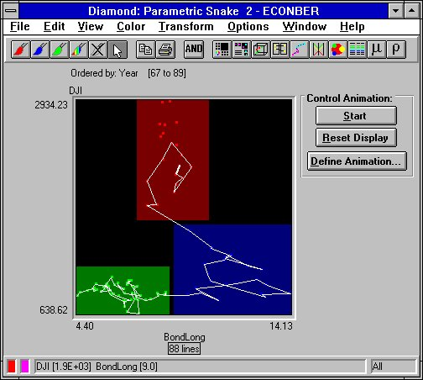
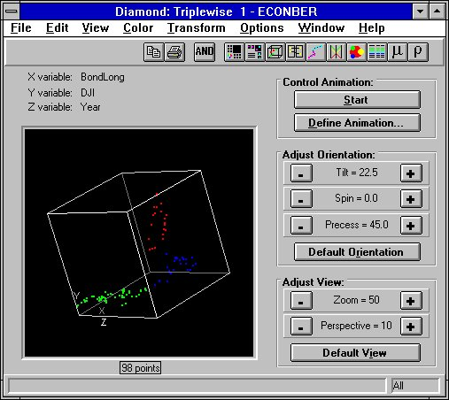
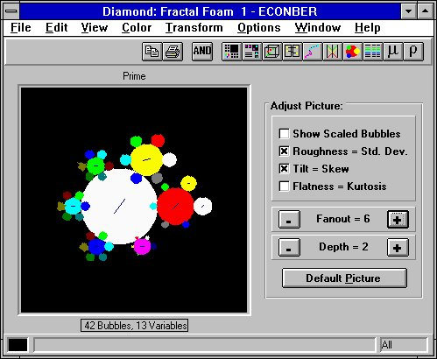
Brushing Across Different Projection Types
67
197.892
0.329
24.165
2241.8
57.6
67.8
67.5
198.911
0.334
24.662
2287.7
56.5
71.3
68
199.92
0.341
25.818
2327.3
59.4
77.3
68.5
200.898
0.349
27.661
2385.3
60.7
83.6
69
201.881
0.357
28.784
2416.5
62.6
85.8
69.5
202.877
0.368
29.037
2433.2
63.9
86.4
70
204.008
0.379
30.449
2408.6
62.1
85.4
70.5
205.295
0.389
31.573
2435.8
61.7
87.7
71
206.668
0.399
32.893
2478.6
61.5
93.4
71
71.5
206.668
207.881
0.399
0.406
34.431
32.893
2491.1
2478.6
62
61.5
98.5
72
209.061
0.412
35.762
2545.6
65.6
93.4
71.5
207.881
0.406
34.431
2491.1
62
105.7
72.5
210.075
0.418
38.033
2622.1
67.6
98.5
72
209.061
0.412
35.762
2545.6
65.6
112.3
73
211.12
0.427
41.542
2734
71.8
105.7
72.5
210.075
0.418
38.033
2622.1
67.6
126.3
73.5
212.092
0.442
42.542
2738.3
74.4
112.3
73
211.12
0.427
41.542
2734
71.8
125
74
213.074
0.468
43.211
2747.4
73
126.3
73.5
212.092
0.442
42.542
2738.3
74.4
120.2
74.5
214.042
0.493
46.062
2719.3
73.6
125
74
213.074
0.468
43.211
2747.4
73
130.2
75
215.065
0.523
46.505
2642.7
66.3
120.2
74.5
214.042
0.493
46.062
2719.3
73.6
124.8
75.5
216.195
0.54
49.618
2714.9
65.7
130.2
75
215.065
0.523
46.505
2642.7
66.3
140
76
217.249
0.558
52.886
2804.4
69.9
124.8
75.5
216.195
0.54
49.618
2714.9
65.7
156.4
76.5
218.233
0.57
54.991
2828.6
72.5
140
76
217.249
0.558
52.886
2804.4
69.9
162.4
77
219.344
0.587
56.999
2896
75.5
156.4
76.5
218.233
0.57
54.991
2828.6
72.5
177
77.5
220.458
0.608
60.342
3001.8
78.9
162.4
77
219.344
0.587
56.999
2896
75.5
186.5
78
221.629
0.627
61.24
3020.5
78.8
177
78.5
222.805
0.655
67.136
3142.6
83.3
188.9
77.5
220.458
0.608
60.342
3001.8
78.9
210
79
224.053
0.685
71.174
3181.7
85.1
186.5
78
221.629
0.627
61.24
3020.5
78.8
215.6
79.5
225.295
0.73
73.667
3207.4
85.6
188.9
80
226.656
0.78
79.407
3233.4
85.9
223.9
80.5
227.94
0.826
79.311
3159.1
81.2
225
81
229.054
0.872
84.943
3261.1
85.2
218.7
81.5
230.168
0.915
86.806
3264.6
87.1
241.1
82
231.29
0.944
85.994
3170.4
82.4
246.9
82.5
232.378
0.975
88.977
3154.5
82
245.1
83
233.462
0.979
91.607
3186.6
80.8
252.8
83.5
234.49
0.998
98.885
3306.4
85.3
266.7
84
235.525
1.021
105.133
3451.7
91
295.2
84.5
322.7
85
85.5
86
86.5
87
87.5
236.548
237.608
238.68
239.794
240.862
241.943
243.03
1.041
1.057
1.077
1.099
1.095
1.115
1.139
106.781
110.393
114.419
118.477
119.593
119.247
129.921
3520.6
3577.5
3635.8
3721.1
3712.4
3781.2
3858.9
93.9
93.1
94.1
96.1
94.8
96.5
100.8
337.7
361.4
387.2
381.8
426.4
403.3
441.3
Notes:
Diamond software
Line visualization as a sequence
Parallel coordinates
3D Scatterplot
Bubble plot
Tabular data in back

Slide 24
Glyphs
Glyph
  composite graphical objects where different geometric and visual attributes are used to encode multidimensional data structures in combination.
Examples:
  Superquadrics for DTI
  Chernoff Face*
    mapping k-dimensions to facial features
*Herman Chernoff, "The use of faces to represent points in k-dimensional space graphically," J. Am. Stat. Assoc., v68, 361-368 (1973).
Notes:
Glyphs are a type of mark that can exhibit multiple attributes of data

Slide 25
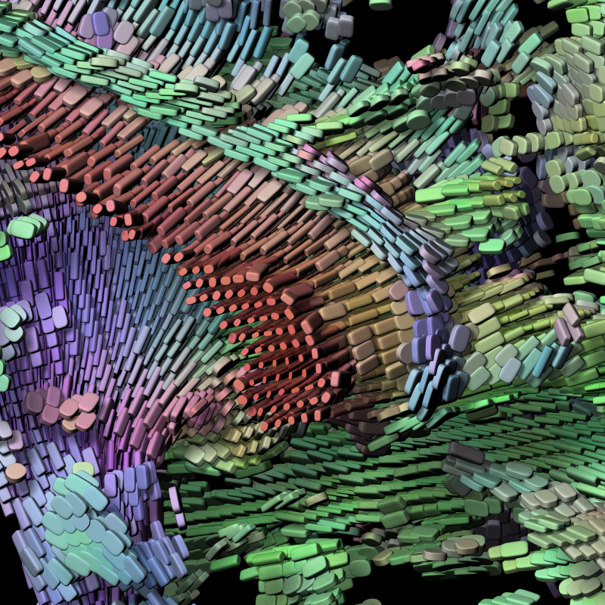
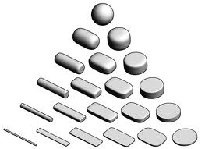
Superquadric glyphs for DT-MRI
Determine structure of brain tissue, examining movement along N different axes
G. Kindlmann, University of Utah / University of Chicago

Slide 26
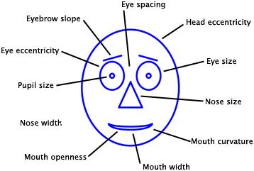
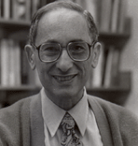
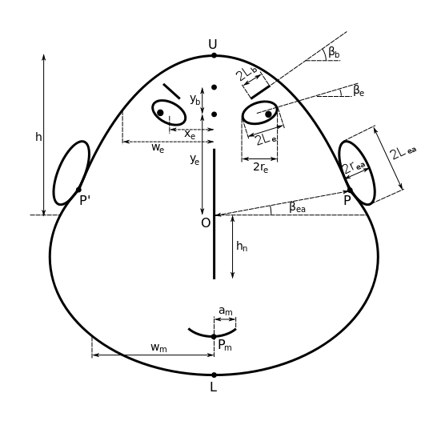
Glyphs: Chernoff Faces
http://www.stat.harvard.edu/People/Faculty/Herman_Chernoff/
http://hesketh.com/schampeo/projects/Faces/chernoff.html

Slide 27
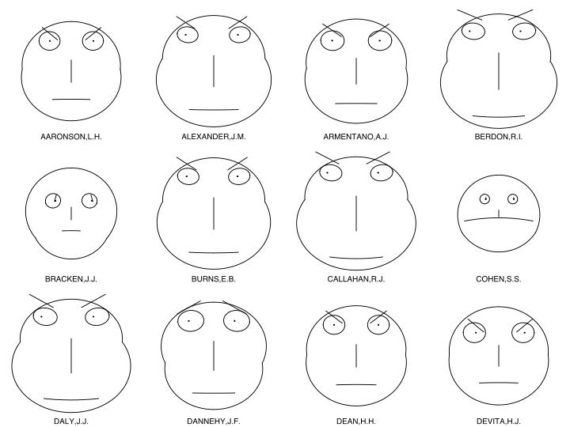


Chernoff Face Example
Map to 10 dimension binary vector
Evaluation Of Judges
[0, 0, 0, 0, 0, 0, 0, 0, 0, 0]
[1, 1, 1, 1, 1, 1, 1, 1, 1, 1]

Slide 28
Star Glyph
What’s a problem with using star glyphs?
d1
d7
d2
d6
d3
d5
d4

Slide 29
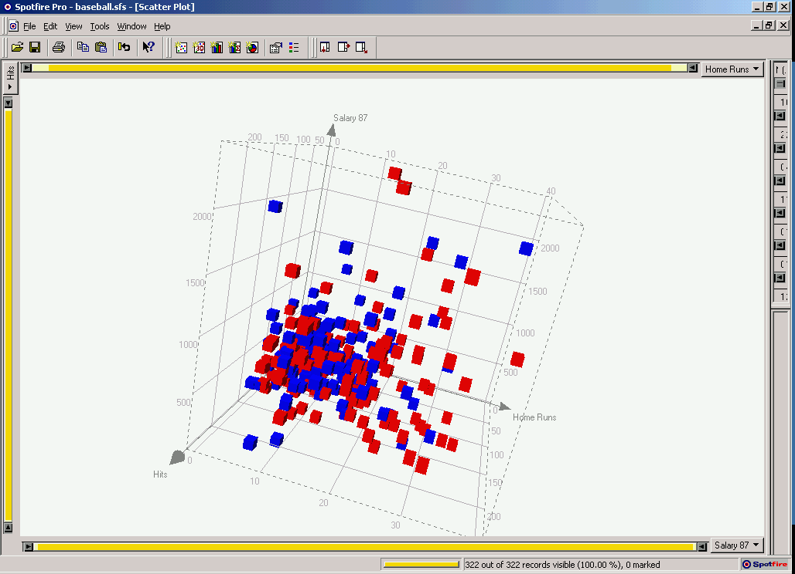
Using additional axes
Easy example:
  2D scatter plot → 3D scatter plot
Space > 3D ?

Slide 30
Parallel Coordinates
Instead of orthogonal axes, let’s go parallel
(0,1,-1,2)=
x
y
z
w
0
0
0
0
Inselberg, “Multidimensional detective” (parallel coordinates)

Slide 31
Parallel Coordinates
Important factors:
  the scaling of the axes.
  the order of the axes
  the rotation of the axes

Slide 32
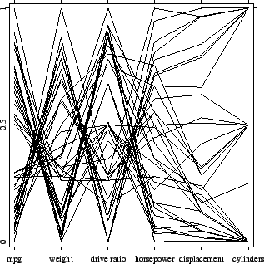
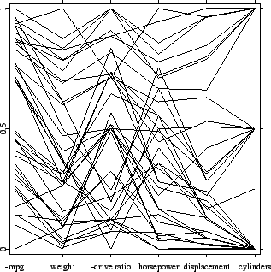
Parallel Coordinates

Slide 33
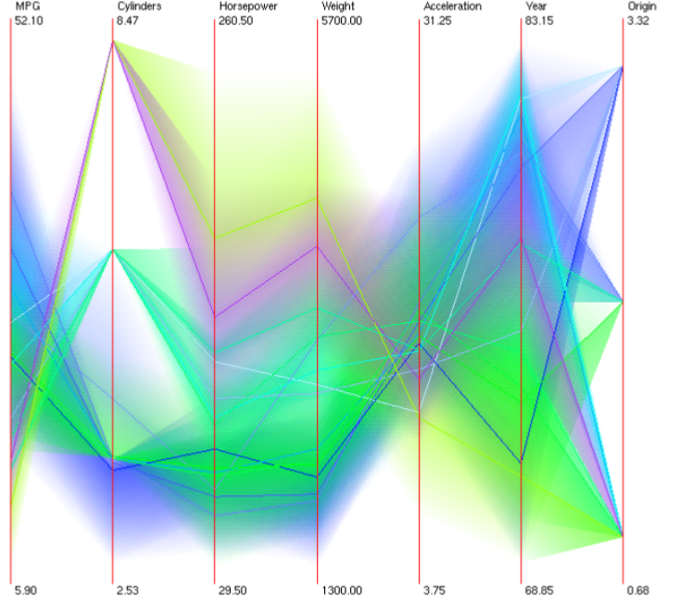
Parallel Coordinates
Better visualizations
http://davis.wpi.edu/xmdv/

Slide 34
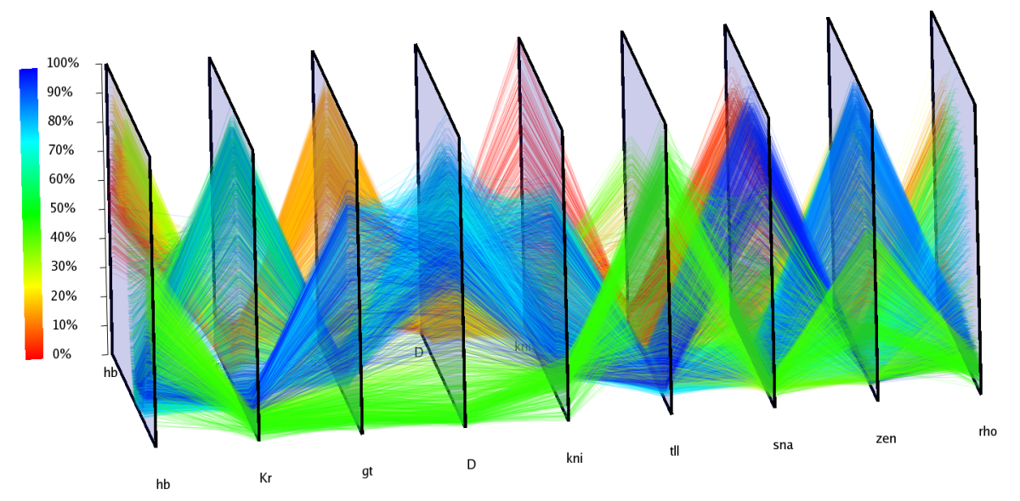
Parallel Coordinates
3D parallel coordinates
  http://www-vis.lbl.gov/Events/SC07/Drosophila/3DParallelCoordinates.png

Slide 35
Using non- orthogonal axes
Star plot
1
8
2
7
3
6
5
4
Parallel Coordinates with axes arranged radially

Slide 36
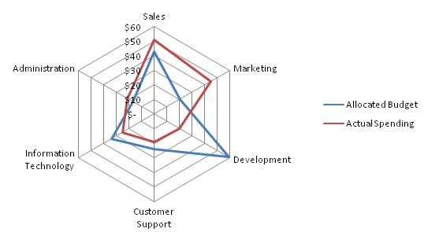
Star Plot example

Slide 37
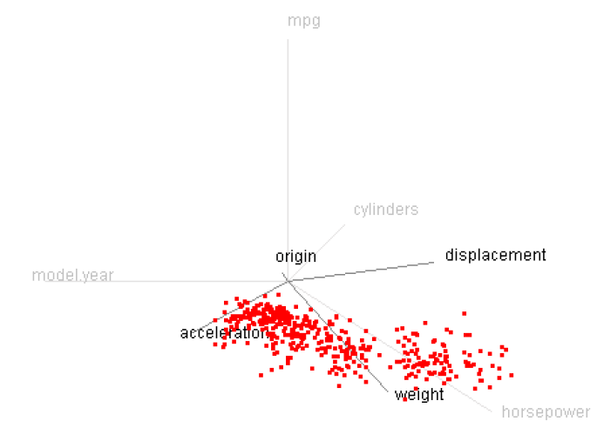
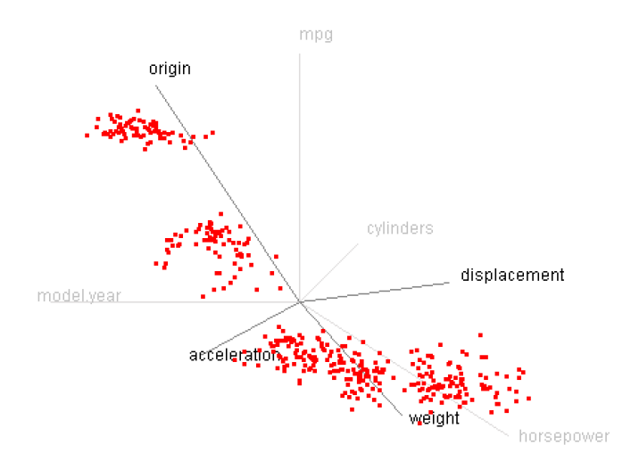
Star Coordinates Example
Notes:
Take 10D data, ignore 4 of them, focus on 3 active dimensions

Slide 38
Star plot vs. Star coordinates

Slide 39
Visualizing Structured Data
Some data contains relationships between entities
  Tree Structures
    Phylogenetic Trees
    Presidential voting by state, county and precinct
  Generalized relations
    Who knows whom in a college dorm
    Who follows whom on Twitter

Slide 40
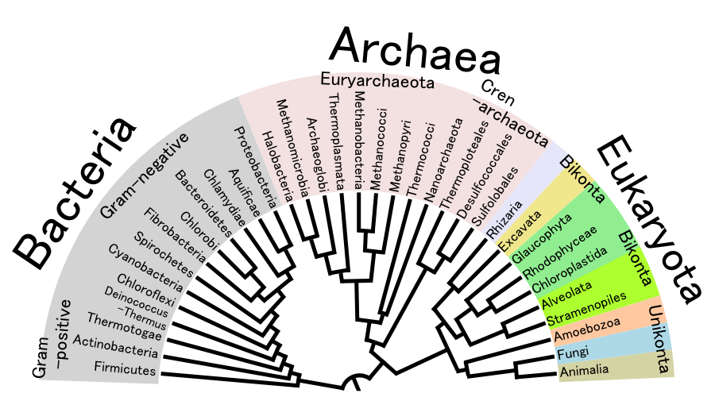
Tree-Structured Data
Phylogenetic Trees
Notes:
First 3 levels of the tree of life – Linnaeus classification of species

Slide 41
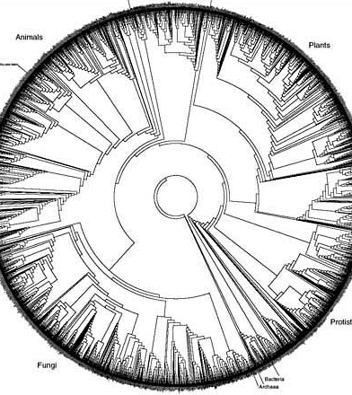
Can Get Busy

Slide 42
Tree-Structure With Values
Suppose we know the breakdown of votes for each precinct in the country….
USA
Alabama
…
Delaware
…
Wyoming
NewCastle
Kent
Sussex
P1
P2
P3
…
Pn
100 227 336 192

Slide 43
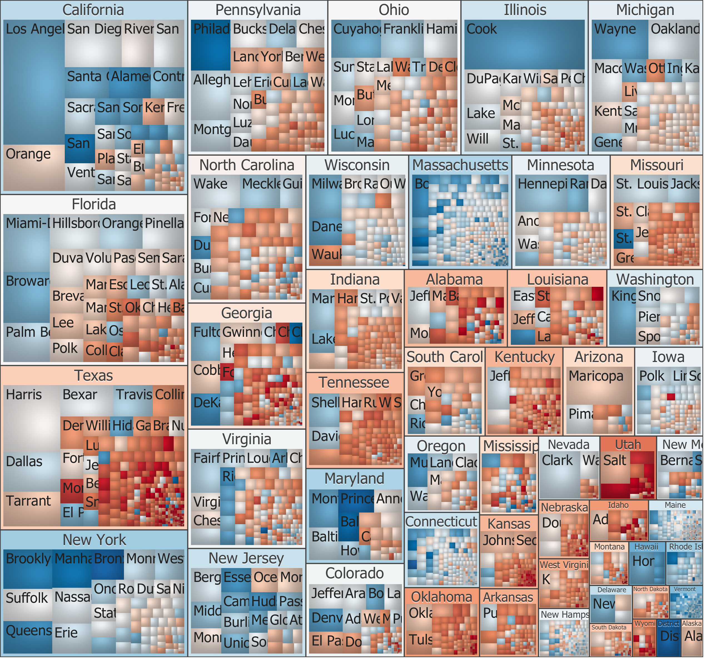
Treemaps

Slide 44
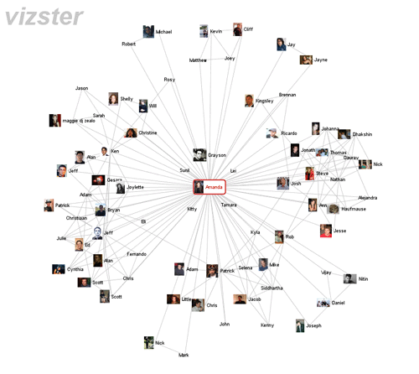
Generalized Relation Data
Bob knows Bill
Bill knows Ted
Ted knows Ann
Bill knows Ann
Bob knows Ken
...

Slide 45
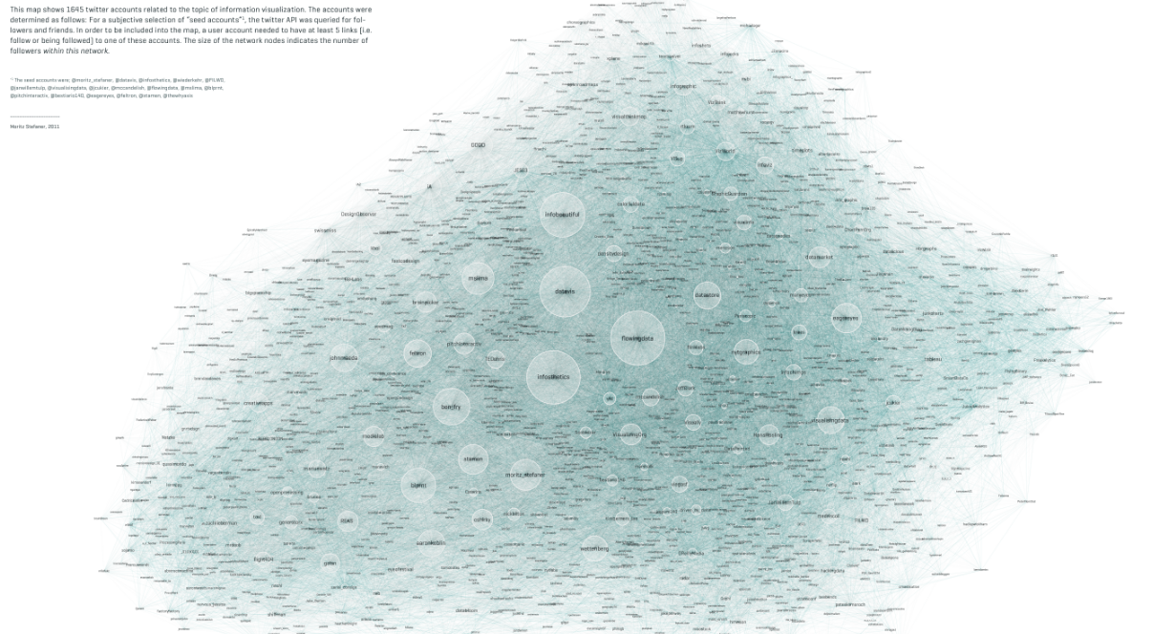
Gets Busy Fast…
Notes:
1645 twitter accounts relating to infovis

Slide 46
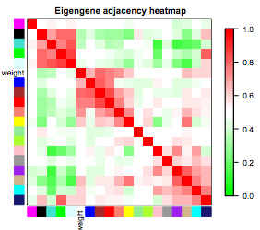
Relation Data With Weights
Bob likes Bill a little
Bill likes Ted a lot
Ted dislikes Ann
Bill really likes
Bob despises Ken
...

Slide 47
Information visualization …
General Aims
  Use human perceptual capabilities
  To gain insights into large and abstract data sets that are difficult to extract using standard query languages
Exploratory Visualization
  Look for structure, patterns, trends, anomalies, relationships
  Provide a qualitative overview of large, complex data sets
  Assist in identifying region(s) of interest and appropriate parameters for more focused quantitative analysis

Slide 48
Techniques
Lots and Lots
  And as many permutations as there are graduate students
Few really general applications
  Excel
Lots of Toolkits
  In particular, in Javascript for web applications
Notes:
Mention spotfire, tableau

Slide 49
Good visualization
Use of computer-supported, interactive, visual representations of abstract data to amplify cognition
  Visual representation can enhance recognition
    Recognition of patterns
    Abstraction and aggregation
    Perceptual interference
  Facilitate data exploration
    Interactive medium
    High data density
    Greater access speed
  Increased analytic resources
    Parallel perceptual processing
    Offload work from cognitive to perceptual system

Slide 50
Fun Websites
Atlas of Science (Katy Borner, IU)
  http://scimaps.org/atlas/maps
Many Eyes: a project to encourage sharing and conversation around visualizations (need java)
  http://manyeyes.alphaworks.ibm.com/
New York Times Infographics
  http://www.smallmeans.com/new-york-times-infographics/
Gap Minder http://www.gapminder.org
How to visualize data with Chernoff face using R
  http://flowingdata.com/2010/08/31/how-to-visualize-data-with-cartoonish-faces/

Slide 51
Reference materials
References
  E.R. Tufte, The Visual Display of Quantitative Information, Graphics Press, 1983.
  S.K. Card, J.D. Mackinlay, and B. Shneiderman, Information Visualization: Using Vision to Think, Morgan Kaufmann Publishers, 1999.
Software
  Matplotlib/Python
  Google charts/Javascript
  InfoVis ToolKit
  Prefuse
  Titan Libraries/VTK InfoVis Libraries

